Slide 1

LLaMA From Scratch (LLaMA 1 & LLaMA 2)

Slide 2
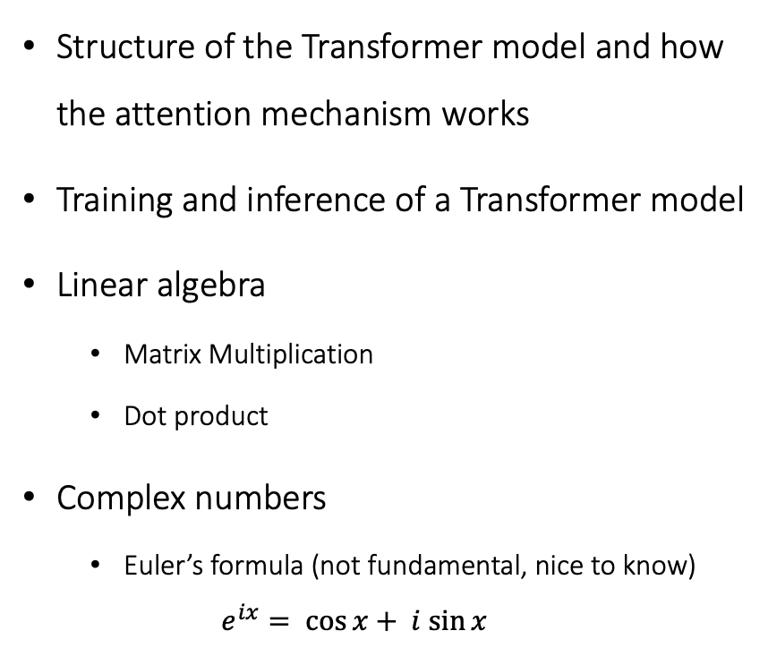
Prerequisites
Topics
Structure of the Transformer model and how the attention mechanism works
Training and inference of a Transformer model
Linear algebra
Matrix Multiplication
Dot product
Complex numbers
Euler’s formula (not fundamental, nice to know)
$$e^{ix}= \cos{x}+ i sin{x}$$
Architectural differences between vanilla Transformer and LLaMA
RMS Normalization (with review of Layer Normalization)
Rotary Positional Embeddings
KV-Cache
Multi-Query Attention
Grouped Multi-Query Attention
SwiGLU Activation Function

Slide 3
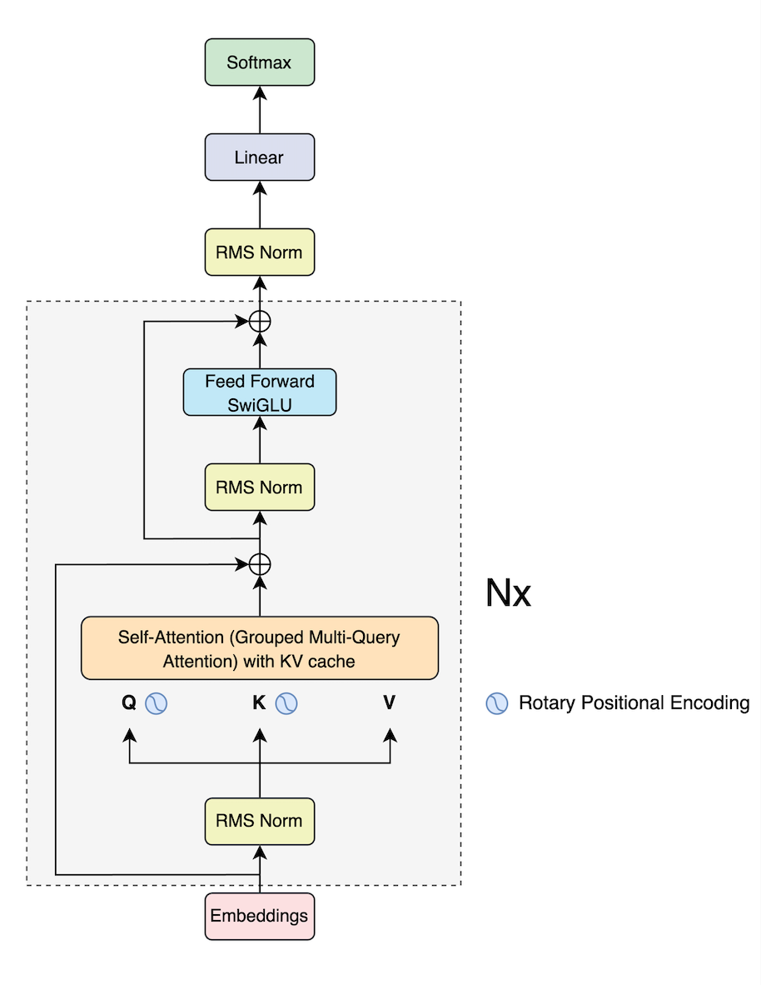

Transformer vs LLaMA
Transformer
LLaMA
(“Attention is All You Need”)

Slide 4
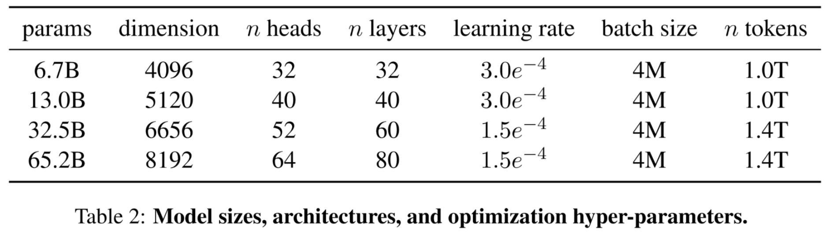
Models (LLaMA 1)

Slide 5
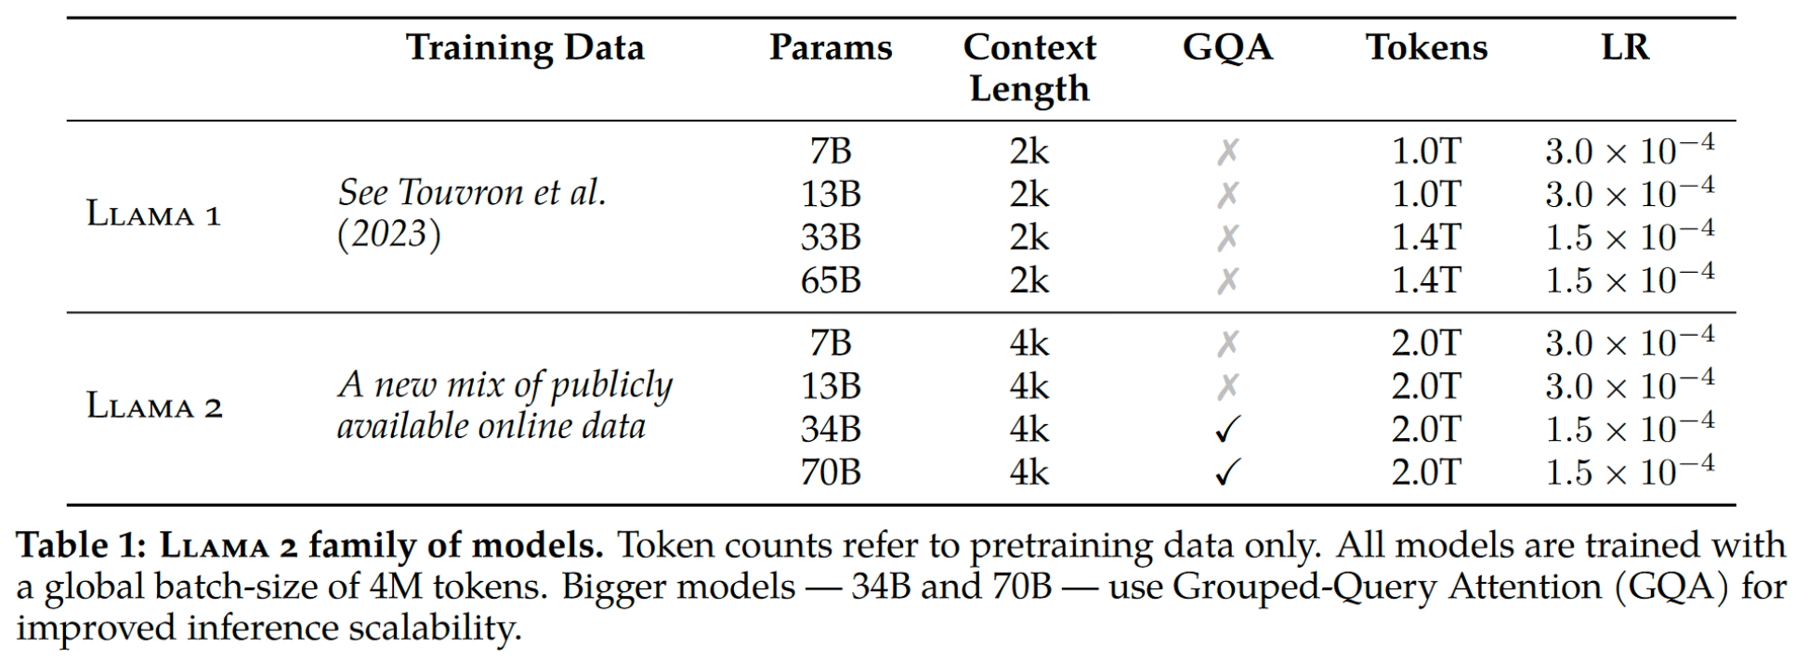
Models (LLaMA 2)

Slide 6
Let’s review the Embeddings!
LLaMA

Slide 7
What is an input embedding?
Original sentence
(tokens)
YOUR
CAT
IS
A
LOVELY
CAT
Input IDs
(position in the
vocabulary)
105
6587
5475
3578
65
6587
952.207
171.411
621.659
776.562
6422.693
171.411
5450.840
3276.350
1304.051
5567.288
6315.080
3276.350
1853.448
9192.819
0.564
58.942
9358.776
9192.819
Embedding
(vector of size 512)
...
...
...
...
...
...
1.658
3633.421
7679.809
2716.419
2141.081
3633.421
2671.529
8390.473
4509.025
5119.949
735.147
8390.473

Slide 8
What is normalization?
LLaMA

Slide 9
Let’s review a simple neural network!
Target
Loss
Input
Hidden Layer 1
Hidden Layer 2
Output

Slide 10
A simple parallel: The bad CEO in a phone factory
Target
CEO
Raw Materials
Hardware Team
Software Team
Output

Slide 11

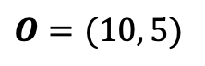
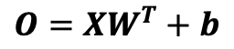
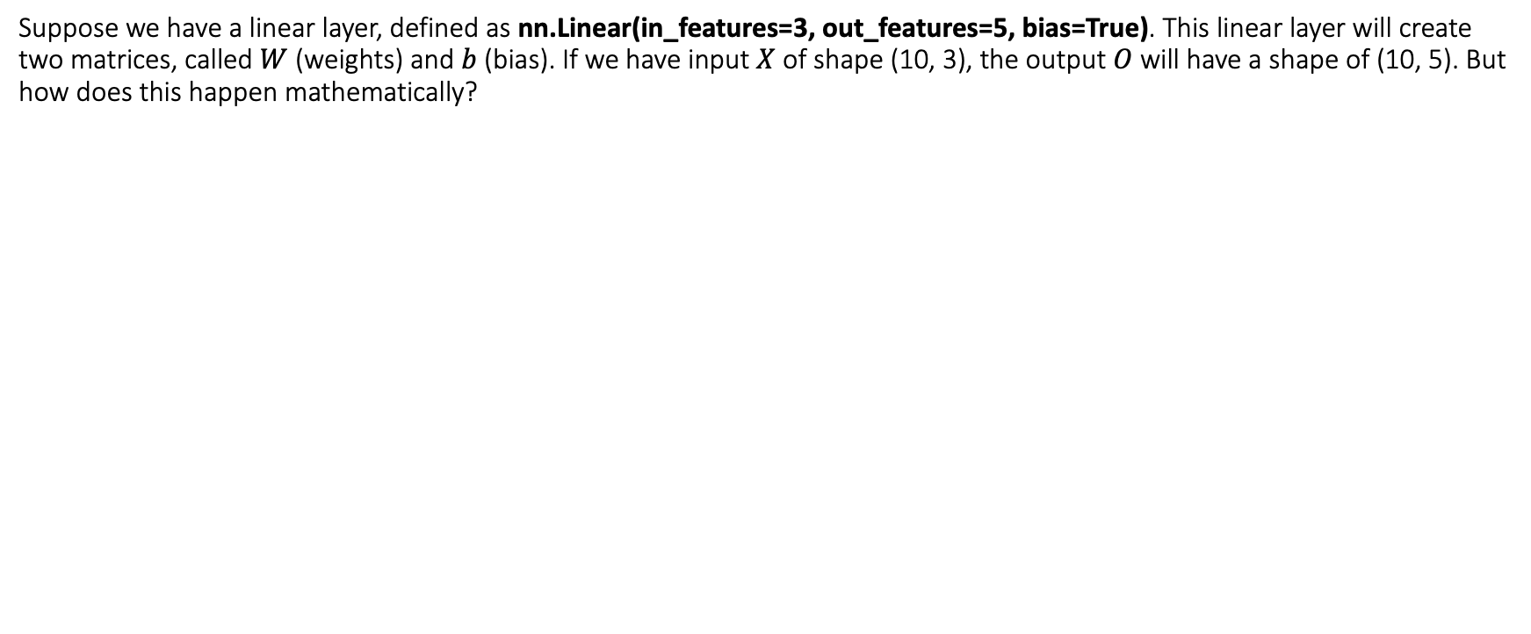
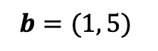
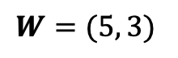
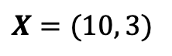
Let’s review the math in neural networks!
Suppose we have a linear layer, defined as nn.Linear(in_features=3, out_features=5, bias=True). This linear layer will create two matrices, called $W$ (weights) and $b$ (bias). If we have input $X$ of shape (10, 3), the output $O$ will have a shape of (10, 5). But how does this happen mathematically?
$$O=XW^{T}+b$$
*We usually apply a non-linearity to the output matrix $O$
$$X=(10, 3)$$
$$W=(5, 3)$$
$$b=(1, 5)$$
$$O=(10, 5)$$
Each neuron has 3 weights, one for each of the input feature. Each neuron has 1 bias that is added.

Slide 12
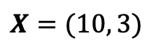
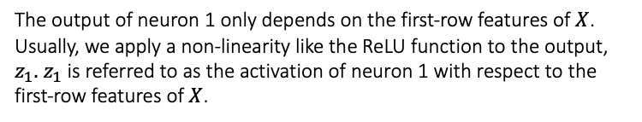


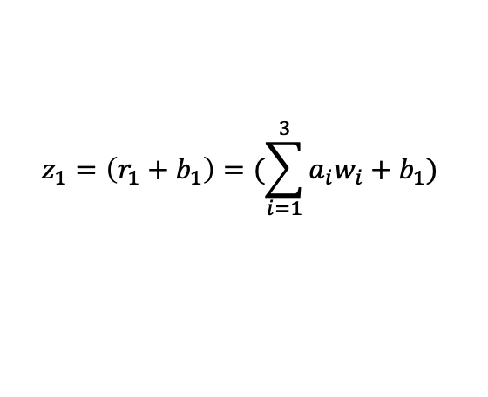

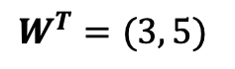

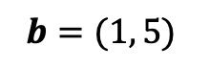
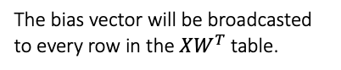
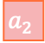


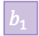

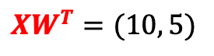

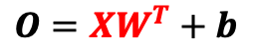
Let’s review the math in neural networks!
$$z_{1}=\left(r_{1}+b_{1}\right)=(\sum_{i=1}^{3}{a_{i}w_{i}+b_{1}})$$
$$b=(1, 5)$$
$$b_{1}$$
The bias vector will be broadcasted to every row in the $XW^{T}$ table.
The output of neuron 1 only depends on the first-row features of $X$. Usually, we apply a non-linearity like the ReLU function to the output, $z_{1}.$ $z_{1}$ is referred to as the activation of neuron 1 with respect to the first-row features of $X$.
$$+$$
$$a_{1}$$
$$a_{2}$$
$$a_{3}$$
$$r_{1}$$
$$z_{1}$$
$$O=XW^{T}+b$$
$$w_{1}$$
$$X=(10, 3)$$
$$W^{T}=(3, 5)$$
$$w_{2}$$
$$XW^{T}=(10, 5)$$
$$O=(10, 5)$$
$$w_{3}$$

Slide 13
Let’s review the math in neural networks!
The output of a neuron depends on the features of the input data (and the neuron’s parameters).
We can think of the input to a neuron as the output of the previous layer.
If the previous layer (after its weights are updated because of gradient descent) changes drastically, its output (the next layer), will have its input changed drastically as well. So, it will be forced to re-adjust its weights drastically in turn at the next step of gradient descent.
The phenomenon by which the distributions of internal nodes (neurons) of a neural network change is referred to as Internal Covariate Shift. And we want to avoid it because it makes training neural networks slower, as the neurons are forced to drastically re-adjust their weights in one direction or another because of drastic changes in the outputs of the previous layer.

Slide 14
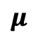
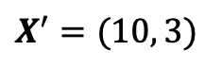

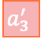

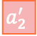

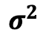
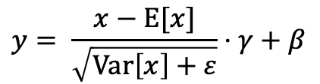
A Solution: Layer Normalization
$$y= \frac{x−\text{E}[x]}{\sqrt{\text{Var}\left[x\right]+ε}}⋅γ+β$$
$$μ$$
$$σ^{2}$$
Each item is updated with its normalized value, which will turn it into a normal distribution with 0 mean and variance of 1.
These two parameters gamma and beta are learnable parameters that allow the model to “amplify” the scale of each feature or apply a translation to the feature according to the needs of the loss function.
$$a_{1}$$
$$a_{2}$$
$$a_{3}$$
$$μ_{1}$$
$$σ_{1}^{2}$$
$$a_{1}^{′}$$
$$a_{2}^{′}$$
$$a_{3}^{′}$$
$$X=(10, 3)$$
$$X^{′}=(10, 3)$$
With Batch Normalization, we normalize by columns (features).
With Layer Normalization, we normalize by rows (data items).

Slide 15
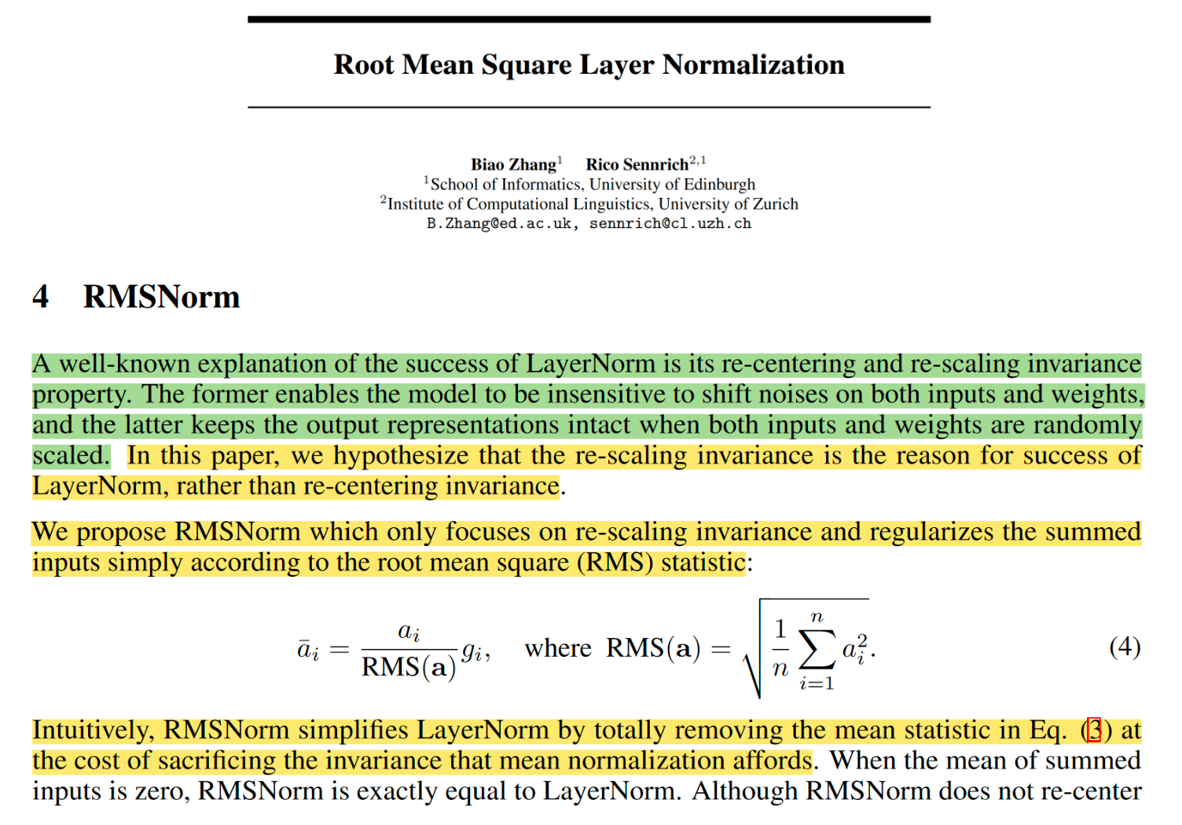
Root Mean Square Normalization
Just like Layer Normalization, we also have a learnable parameter gamma (g in the formula on the left) that is multiplied by the normalized values.

Slide 16
Why RMSNorm?
Requires less computation compared to Layer Normalization.
It works well in practice.

Slide 17
Let’s review Positional Encodings!
LLaMA

Slide 18
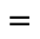
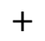
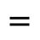
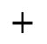
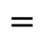
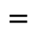
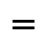
What is an input embedding?
Original sentence
(tokens)
YOUR
CAT
IS
A
LOVELY
CAT
952.207
171.411
621.659
776.562
6422.693
171.411
Embedding
(vector of size 512)
...
...
...
...
...
...
1853.448
9192.819
0.564
58.942
9358.776
9192.819
$$+$$
$$+$$
$$+$$
$$+$$
$$+$$
$$+$$
Positional Embedding
(vector of size 512)
Only computed once and reused for every sentence during training and inference
...
2620.399
...
...
...
2620.399
...
...
...
...
...
...
...
9386.405
...
...
...
9386.405
$$=$$
$$=$$
$$=$$
$$=$$
$$=$$
$$=$$
...
2791.810
...
...
...
2791.810
Encoder Input
(vector of size 512)
...
...
...
...
...
...
...
18579.224
...
...
...
18579.224

Slide 19
What is Rotary Positional Encoding?
LLaMA

Slide 20
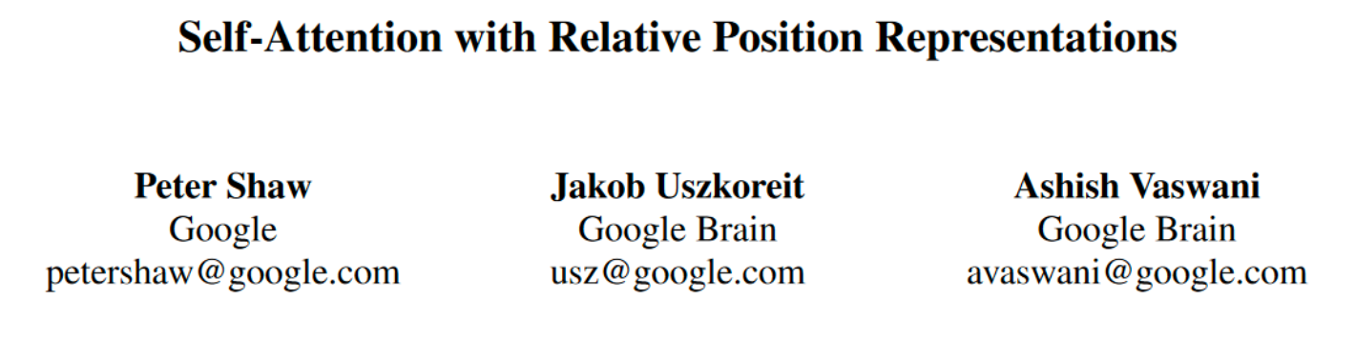
What’s the difference between the absolute positional encodings and the relative ones?
Absolute positional encodings are fixed vectors that are added to the embedding of a token to represent its absolute position in the sentence. So, it deals with one token at a time. You can think of it as the latitude and longitude on a map: each point on earth will have a unique pair.
Relative positional encodings, on the other hand, deals with two tokens at a time and it is involved when we calculate the attention: since the attention mechanism captures the “intensity” of how much the two words are related to each other. Relative positional encodings tell the attention mechanism the distance between the two words involved in it. So, given two tokens, we create a vector that represents their distance.
Relative positional encodings were introduced in the following paper:

Slide 21
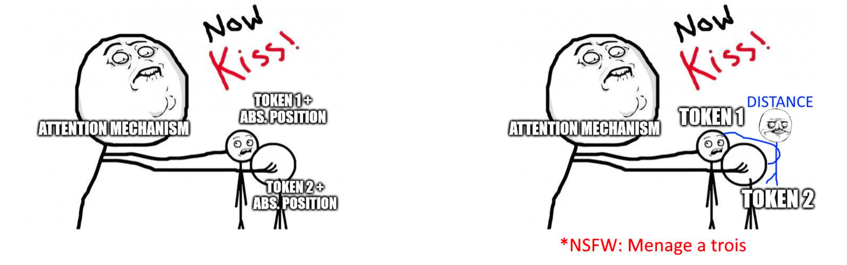
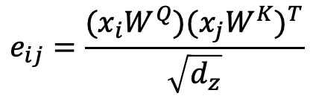
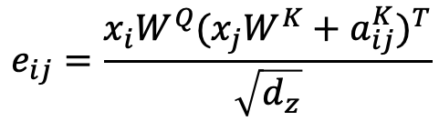
Relative Positional Encodings
From “Self-Attention with Relative Position Representations”
Absolute Positional Encodings
From “Attention is All You Need”
$$e_{ij}=\frac{(x_{i}W^{Q}){(x_{j}W^{K})}^{T}}{\sqrt{d_{z}}}$$
$$e_{ij}=\frac{x_{i}W^{Q}{(x_{j}W^{K}+a_{ij}^{K})}^{T}}{\sqrt{d_{z}}}$$

Slide 22
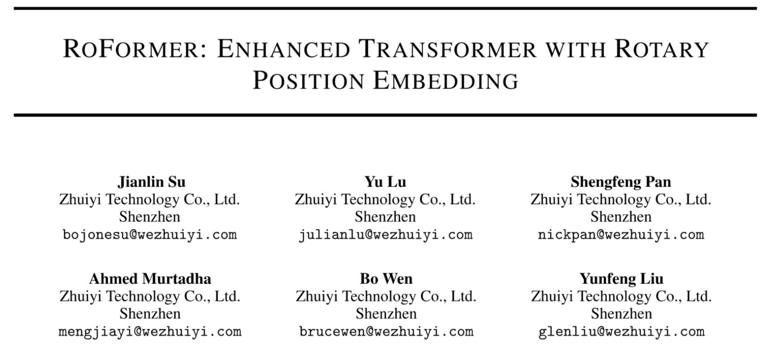
Rotary Positional Embeddings

Slide 23
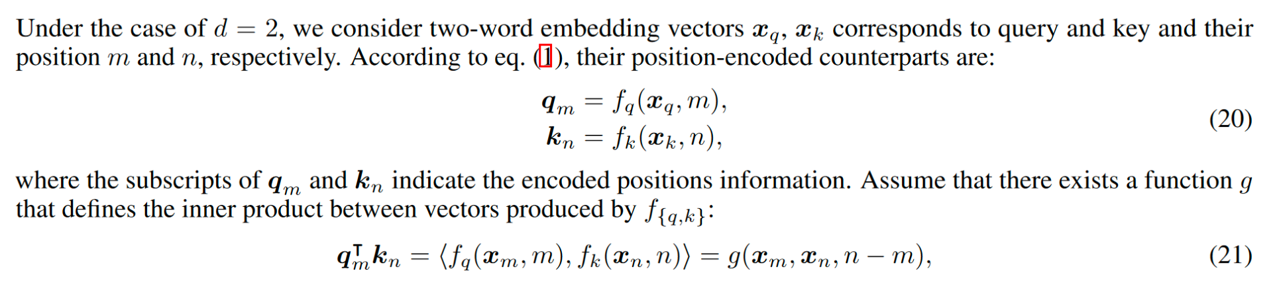
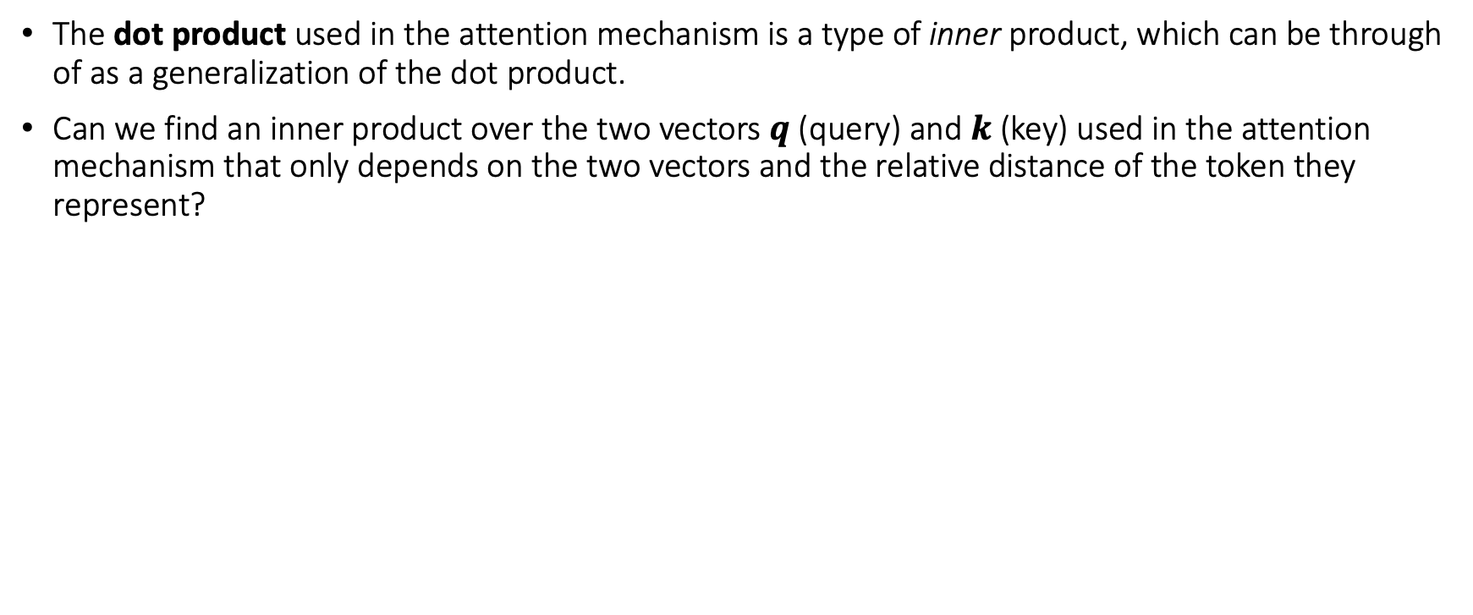
Rotary Position Embeddings: The inner product
The dot product used in the attention mechanism is a type of inner product, which can be through of as a generalization of the dot product.
Can we find an inner product over the two vectors $q$ (query) and $k$ (key) used in the attention mechanism that only depends on the two vectors and the relative distance of the token they represent?

Slide 24
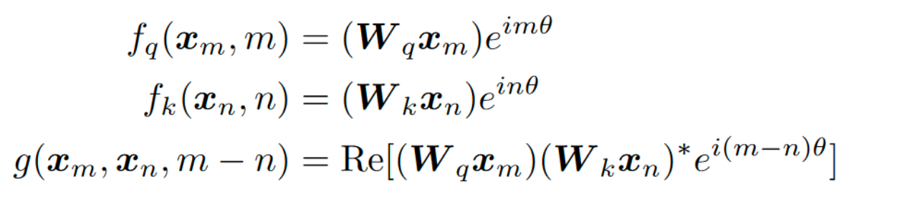
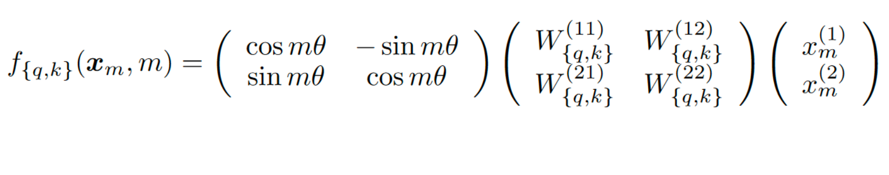
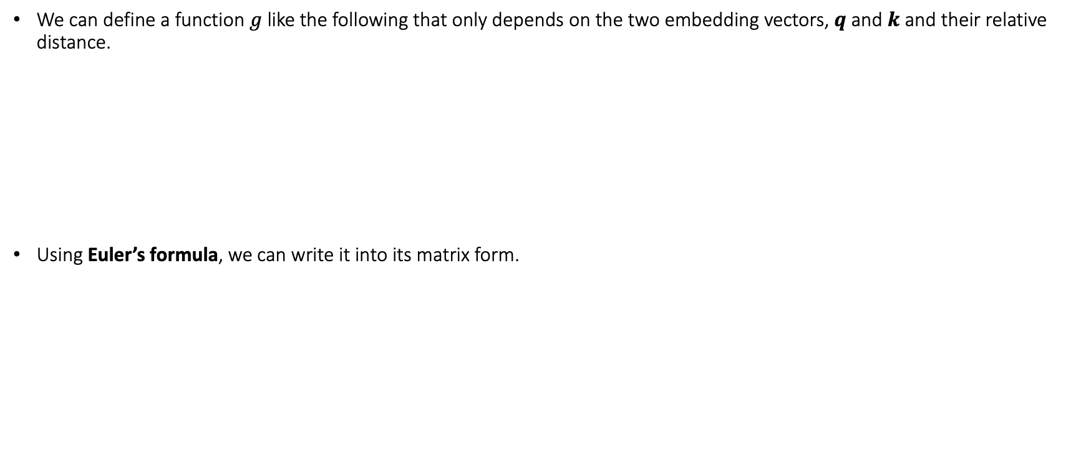
Rotary Position Embeddings: The inner product
We can define a function $g$ like the following that only depends on the two embedding vectors, $q$ and $k$ and their relative distance.
Using Euler’s formula, we can write it into its matrix form.
* = Conjugate of the complex number
Rotation matrix in a 2D space, hence the name rotary position embeddings

Slide 25
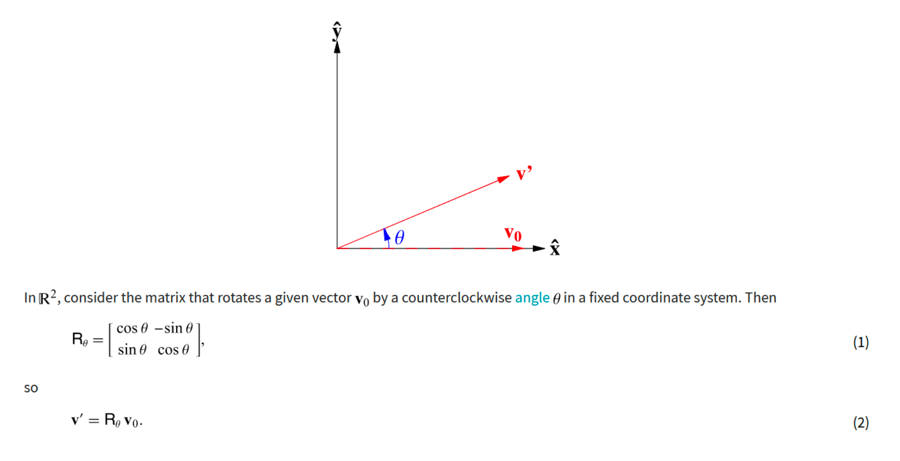
Rotary Position Embeddings: The rotation matrix

Slide 26
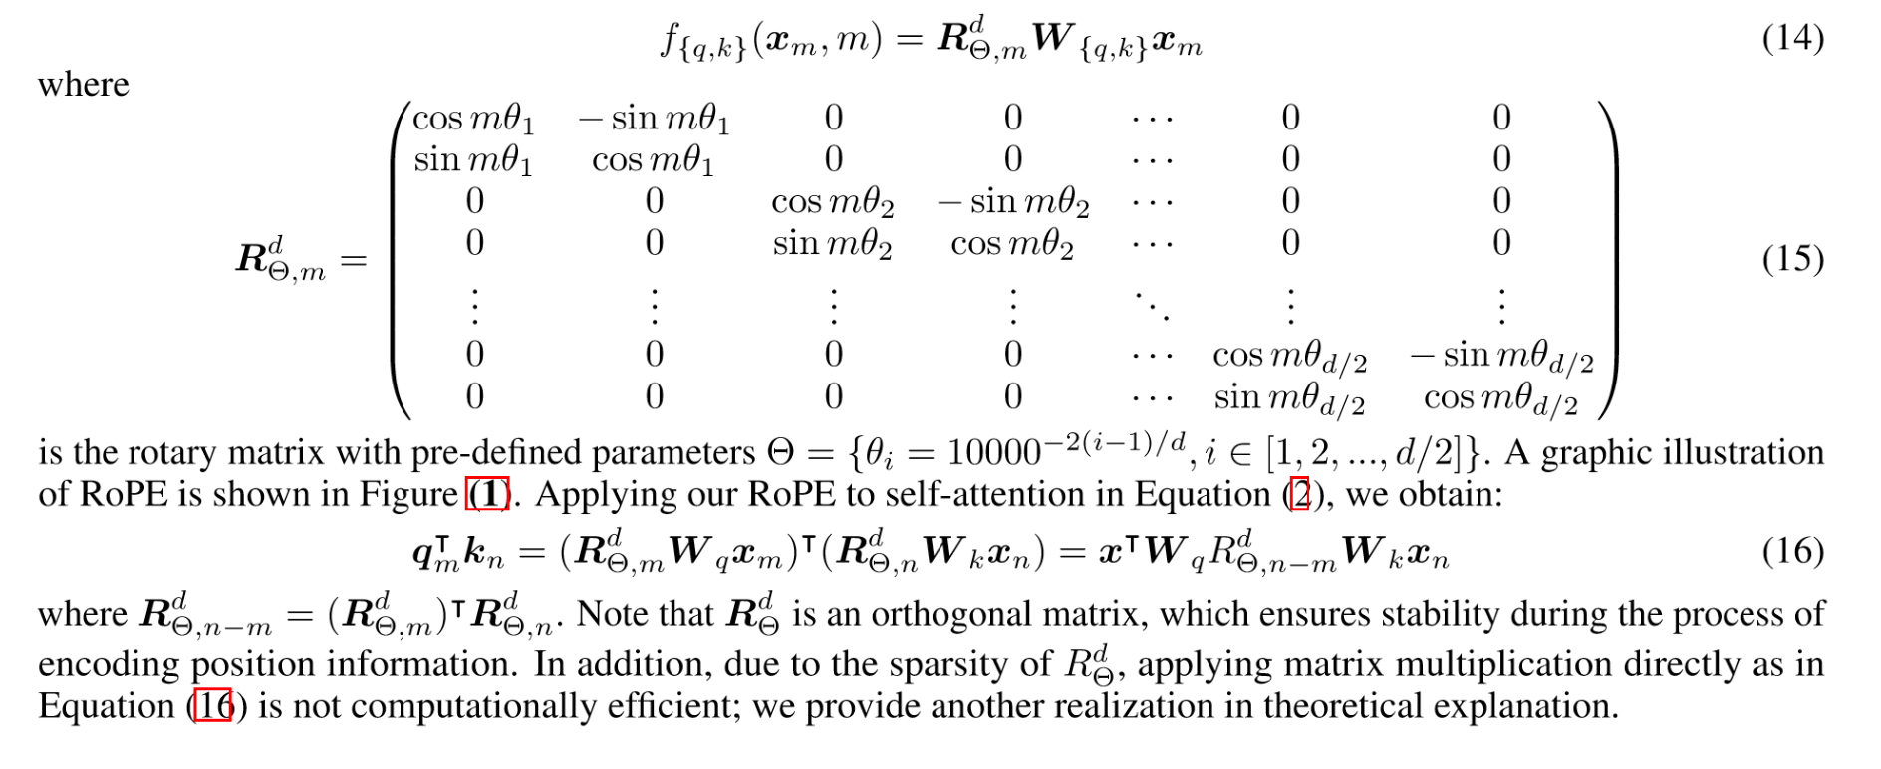
Rotary Position Embeddings: The general form
Since the matrix is sparse, it is not convenient to use it to compute the positional embeddings.

Slide 27
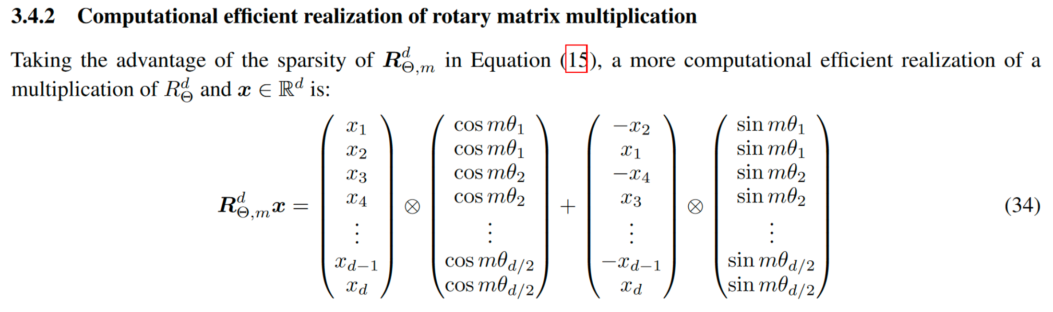
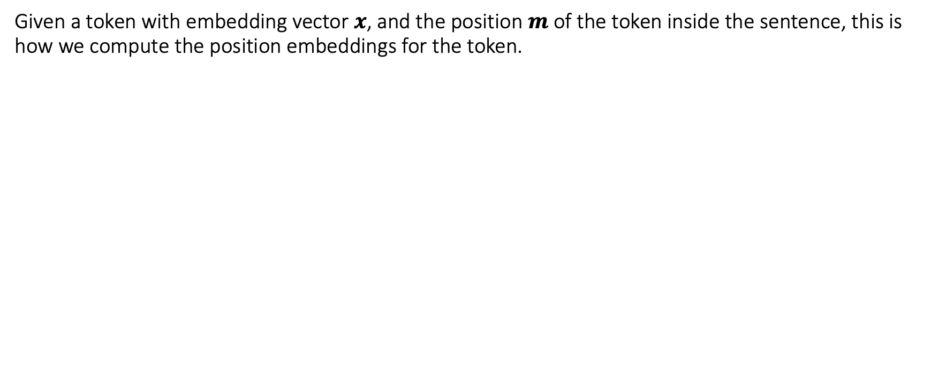
Rotary Position Embeddings: The computationally-efficient form
Given a token with embedding vector $x$, and the position $m$ of the token inside the sentence, this is how we compute the position embeddings for the token.

Slide 28
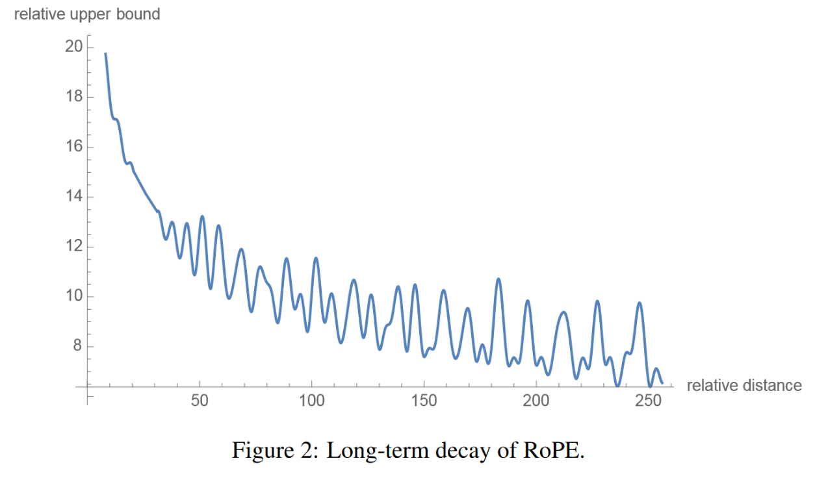
Rotary Position Embeddings: Long-term decay
The authors calculated an upper bound for the inner product by varying the distance between two tokens and proved that it decays with the growth of the relative distance.
This means that the “intensity” of relationship between two tokens encoded with Rotary Positional Embeddings will be numerically smaller as the distance between them grows.

Slide 29
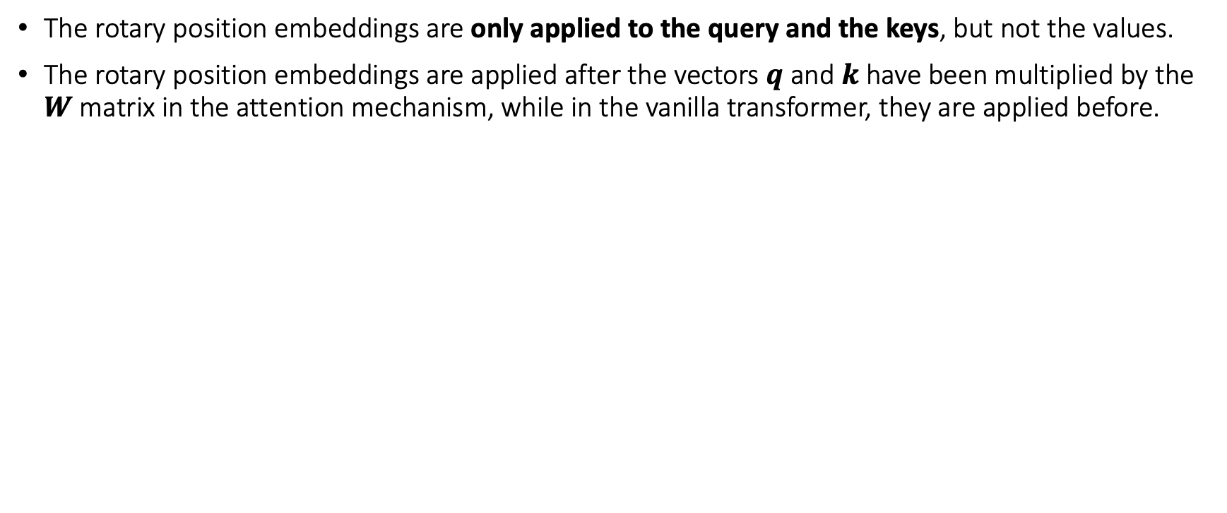
Rotary Position Embeddings: Practical considerations
The rotary position embeddings are only applied to the query and the keys, but not the values.
The rotary position embeddings are applied after the vectors $q$ and $k$ have been multiplied by the $W$matrix in the attention mechanism, while in the vanilla transformer, they are applied before.

Slide 30
Let’s review Self-Attention!
LLaMA

Slide 31





What is Self-Attention?
Self-Attention allows the model to relate words to one another.
In this simple case, we consider the sequence length $\text{seq}=6$ and $d_{\text{model}}=d_{k}=512$.
The matrices $Q$, $K$ and $V$ are just the input sentence.
Q
K^{T}
$$\text{softmax}$$
X
=
* all values are random
(6, 512)
(512, 6)
$$\sqrt{4096}$$
* for simplicity, only one head is considered where $d_{\text{model}}=d_{k}$

Slide 32
How to compute Self-Attention?
Each row in this matrix captures not only the meaning (given by the embedding) or the position in the sentence (represented by the positional embeddings) but also each word’s interaction with other words.
V
Attention
X
=
(6, 512)
(6, 512)

Slide 33
Next Token Prediction Task
Imagine we want to train a model to write Dante Alighieri’s Divine Comedy’s 5th Canto from the Inferno.
Amor, ch'al cor gentil ratto s'apprende,
prese costui de la bella persona
che mi fu tolta; e 'I modo ancor m'offende.
Amor, ch'a nullo amato amar perdona,
mi prese del costui piacer si forte,
che, come vedi, ancor non m'abbandona.
Amor condusse noi ad una morte.
Caina attende chi a vita ci spense.
Love, that can quickly seize the gentle heart,
took hold of him because of the fair body
taken from me-how that was done still wounds me.
Love, that releases no beloved from loving,
took hold of me so strongly through his beauty
that, as you see, it has not left me yet.
Love led the two of us unto one death.
Caina waits for him who took our life.”

Slide 34
Next Token Prediction Task
Target Love that can quickly seize the gentle heart [EOS]
Training
Input [SOS] Love that can quickly seize the gentle heart

Slide 35
Next Token Prediction Task
Output Love
Inference
T=1
Input [SOS]

Slide 36
Next Token Prediction Task
Output Love that
Inference
T=2
Input [SOS] Love

Slide 37
Next Token Prediction Task
Output Love that can
Inference
T=3
Input [SOS] Love that

Slide 38
Next Token Prediction Task
Output Love that can quickly
Inference
T=4
Input [SOS] Love that can

Slide 39
Next Token Prediction Task
Output Love that can quickly seize
Inference
T=5
Input [SOS] Love that can quickly

Slide 40
Next Token Prediction Task
Output Love that can quickly seize the
Inference
T=6
Input [SOS] Love that can quickly seize

Slide 41
Next Token Prediction Task
Output Love that can quickly seize the gentle
Inference
T=7
Input [SOS] Love that can quickly seize the

Slide 42
Next Token Prediction Task
Output Love that can quickly seize the gentle heart
Inference
T=8
Input [SOS] Love that can quickly seize the gentle

Slide 43
Next Token Prediction Task
Output Love that can quickly seize the gentle heart [EOS]
Inference
T=9
Input [SOS] Love that can quickly seize the gentle heart

Slide 44
Next Token Prediction Task: The Motivation behind KV-Cache
At every step of the inference, we are only interested in the last token output by the model, because we already have the previous tokens. However, the model needs access to all previous tokens to decide on which token to output, since they constitute its context (or the “prompt”).
Is there a way to make the model do less computation on the token it has already seen during inference? YES! The solution is KV-Cache!

Slide 45








Self-Attention during Next Token Prediction Task
$$QK^{T}$$
$$Q$$
$$K^{T}$$
$$V$$
$$\text{Attention}$$
Token 1
Token 1
Token 1
Output Token 1
Token 2
Token 2
Token 2
Output Token 2
Token 3
Token 3
Token 3
Output Token 3
Token 4
Token 4
Token 4
Output Token 4
Token 5
$$×$$
$$=$$
$$×$$
Token 5
$$=$$
Output Token 5
Token 6
Token 5
Token 6
Output Token 6
Token 7
Token 6
Token 7
Output Token 7
Token 8
Token 7
Token 8
Output Token 8
Token 9
Token 8
Token 9
Output Token 9
Token 9
(9, 4096)
(4096, 9)
(9, 4096)
(9, 4096)
(9, 9)

Slide 46
Self-Attention during Next Token Prediction Task
$$QK^{T}$$
$$Q$$
$$K^{T}$$
$$V$$
$$\text{Attention}$$
Token 1
Token 1
Output Token 1
$$×$$
$$=$$
$$×$$
$$=$$
Token 1
(1, 4096)
(4096, 1)
(1, 4096)
(1, 4096)
Inference T=1
(1, 1)

Slide 47
Self-Attention during Next Token Prediction Task
$$QK^{T}$$
$$Q$$
$$K^{T}$$
$$V$$
$$\text{Attention}$$
Token 1
Token 1
Output Token 1
Token 2
Token 2
Output Token 2
$$×$$
$$=$$
$$×$$
$$=$$
Token 1
Token 2
(2, 4096)
(4096, 2)
(2, 4096)
(2, 4096)
Inference T=2
(2, 2)

Slide 48
Self-Attention during Next Token Prediction Task
$$QK^{T}$$
$$Q$$
$$K^{T}$$
$$V$$
$$\text{Attention}$$
Token 1
Token 1
Output Token 1
Token 2
Token 2
Output Token 2
Token 3
Token 3
Output Token 3
$$×$$
$$=$$
$$×$$
$$=$$
Token 1
Token 2
Token 3
(3, 4096)
(4096, 3)
(3, 4096)
(3, 4096)
Inference T=3
(3, 3)

Slide 49
Self-Attention during Next Token Prediction Task
$$QK^{T}$$
$$Q$$
$$K^{T}$$
$$V$$
$$\text{Attention}$$
Token 1
Token 1
Output Token 1
Token 2
Token 2
Output Token 2
Token 3
Token 3
Output Token 3
Token 4
Token 4
Output Token 4
$$×$$
$$=$$
$$×$$
$$=$$
Token 1
Token 2
Token 3
Token 4
(4, 4096)
(4096, 4)
(4, 4096)
(4, 4096)
Inference T=4
(4, 4)

Slide 50
1. We already computed these dot products in the previous steps. Can we cache them?
2. Since the model is causal, we don’t care about the attention of a token with its successors, but only with the tokens before it.
3. We don’t care about these, as we want to predict the next token and we have already predicted the previous ones.
$$QK^{T}$$
$$Q$$
$$K^{T}$$
$$V$$
$$\text{Attention}$$
Token 1
Token 1
Output Token 1
Token 2
Token 2
Output Token 2
Token 3
Token 3
Output Token 3
Token 4
Token 4
Output Token 4
$$×$$
$$=$$
$$×$$
$$=$$
Token 1
Token 2
Token 3
Token 4
4. We are only interested in this last row!
(4, 4096)
(4096, 4)
(4, 4096)
(4, 4096)
Inference T=4
(4, 4)

Slide 51


Slide 52
Self-Attention with KV-Cache
$$QK^{T}$$
$$Q$$
$$K^{T}$$
$$V$$
$$\text{Attention}$$
Token 1
Token 1
Output Token 1
$$×$$
$$=$$
$$×$$
$$=$$
Token 1
(1, 4096)
(4096, 1)
(1, 4096)
(1, 4096)
Inference T=1
(1, 1)

Slide 53
Self-Attention with KV-Cache
$$QK^{T}$$
$$Q$$
$$K^{T}$$
$$V$$
$$\text{Attention}$$
Token 1
Token 2
Token 2
Output Token 2
$$×$$
$$=$$
$$×$$
$$=$$
Token 1
Token 2
(2, 4096)
(4096, 2)
(2, 4096)
(2, 4096)
Inference T=2
(2, 2)

Slide 54
Self-Attention with KV-Cache
$$QK^{T}$$
$$Q$$
$$K^{T}$$
$$V$$
$$\text{Attention}$$
Token 1
Token 2
Token 3
Token 3
Output Token 3
$$×$$
$$=$$
$$×$$
$$=$$
Token 1
Token 2
Token 3
(3, 4096)
(4096, 3)
(3, 4096)
(3, 4096)
Inference T=3
(3, 3)

Slide 55
Self-Attention with KV-Cache
$$QK^{T}$$
$$Q$$
$$K^{T}$$
$$V$$
$$\text{Attention}$$
Token 1
Token 2
Token 3
Token 4
Token 4
Output Token 4
$$×$$
$$=$$
$$×$$
$$=$$
Token 1
Token 2
Token 3
Token 4
(4, 4096)
(4096, 4)
(4, 4096)
(4, 4096)
Inference T=4
(4, 4)

Slide 56
What is Grouped Multi-Query Attention?
Before we talk about Grouped Multi-Query Attention (MQA), we need to introduce its predecessor, the Multi-Query Attention (MQA).
LLaMA

Slide 57

GPUs have a “problem”: They are too fast!
In recent years, GPUs have become very fast at performing calculations, insomuch that the speed of computation (FLOPs) is much higher than the memory bandwidth (GB/s) or speed of data transfer between memory areas. For example, NVIDIA A100 can perform 19.5 TFLOPs while having a memory bandwidth of 2TB/s.
This means that sometimes the bottleneck is not how many operations we perform, but how much data transfer our operations need, and that depends on the size and the quantity of the tensors involved in our calculations.
For example, computing the same operation on the same tensor N times may be faster than computing the same operation on N different tensors, even if they have the same size, this is because the GPU may need to move the tensors around.
This means that our goal should not only be to optimize the number of operations we do, but also minimize the memory access/transfers that we perform.

Slide 58

Introducing Multi-Query Attention

Slide 59


Comparing different attention algorithms: Vanilla Batched Multi-Head Attention
Multi-head Attention as presented in the original paper “Attention is All You Need”
By setting $m=n$ (sequence length of query = sequence length of keys and values)
The number of arithmetic operations performed is $O\left(bnd^{2}\right)$
The total memory involved in the operations, given by the sum of all the tensors involved in the calculations (including the derived ones!) is $O\left(bnd+bhn^{2}+d^{2}\right)$
The ratio between the total memory and the number of arithmetic operations is $O\left(\frac{1}{k}+\frac{1}{bn}\right)$
In this case, the ratio is much smaller than 1, which means that the number of memory access we are performing is much less than the number of arithmetic operations, so the memory access is not the bottleneck here.

Slide 60


Comparing different attention algorithms: Batched Multi-Head Attention with KV-cache
Uses the KV-cache to reduce the number of operations performed
By setting $m=n$ (sequence length of query = sequence length of keys and values)
The number of arithmetic operations performed is $O\left(bnd^{2}\right)$
The total memory involved in the operations, given by the sum of all the tensors involved in the calculations (including the derived ones!) is $O\left(bn^{2}d+nd^{2}\right)$
The ratio between the total memory and the number of arithmetic operations is $O\left(\frac{n}{d}+\frac{1}{b}\right)$
When $n≈d$ (the sequence length is close to the size of the embedding vector) or $b≈1$ (batch size is 1), the ratio becomes 1 and the memory access now becomes the bottleneck of the algorithm. For the batch size is not a problem, since it is generally much larger than 1, while for the $\frac{n}{d}$ term, we need to reduce the sequence length. But there’s a better way...

Slide 61


Comparing different attention algorithms: Multi-Query Attention with KV-cache
We remove the $h$ dimension from the $K$ and the $V$, while keeping it for the $Q$. This means that all the different query heads will share the same keys and values.
The number of arithmetic operations performed is $O\left(bnd^{2}\right)$.
Th total memory involved in the operations, given by the sum of all the tensors involved in the calculations (including the derived ones!) is $O\left(bnd+bn^{2}k+{nd}^{2}\right)$.
The ratio between the total memory and the number of arithmetic operations is $O\left(\frac{1}{d}+\frac{n}{nd}+\frac{1}{b}\right)$.
Comparing with the previous approach, we have reduced the expensive term $\frac{n}{d}$ by a factor of $h$.
The performance gains are important, while the model’s quality degrades only a little bit.

Slide 62

Speed and quality comparisons

Slide 63
What is Grouped Multi-Query Attention?
Now, let’s talk about Grouped MQA!
LLaMA

Slide 64


Grouped Multi-Query Attention: A compromise between two extremes
Multi-Head Attention
High quality
Computationally slow
Grouped Multi-Query Attention
A good compromise between quality and speed
Multi-Query Attention
Loss in quality
Computationally fast

Slide 65
What is the SwiGLU activation function?
LLaMA

Slide 66

SwiGLU Activation Function

Slide 67

SwiGLU Activation Function

Slide 68

SwiGLU Activation Function

Slide 69

How well does it perform?

Slide 70

Why SwiGLU works so well?

